Slide 1

50.039 Theory and Practice of Deep Learning W8-S2 Introduction to Attacks and Defense on Neural Networks
Matthieu De Mari

Slide 2
About this week (Week 8)
What are attacks on Neural Networks (NNs)?
Why are attacks an important concept when studying NNs?
What are the different types of attacks and what is the intuition behind basic attacks?
How to defend against such attacks?
State-of-the-art of attacks and defense, open questions in research.

Slide 3
About this week (Week 8)
What are attacks on Neural Networks (NNs)?
Why are attacks an important concept when studying NNs?
What are the different types of attacks and what is the intuition behind basic attacks?
How to defend against such attacks?
State-of-the-art of attacks and defense, open questions in research.

Slide 4
In the last episode
Noising samples is sometimes good enough to produce adversarial samples and make a trained Neural Network malfunction.
This exploits the intrinsic properties/limits of Neural Networks.
The problem, however, is that noising is too random, and is often not guaranteed to work.
Can we implement more advanced attacks, with higher success rates?
Can we “target” these attacks to produce adversarial samples with expected effects on Neural Networks?
And later, can we defend against these attacks?

Slide 5
Some more taxonomy on attacks
Definition (untargeted attack):
The objective of an untargeted attack is to produce an attack sample, which will simply be misclassified.
Noising was an untargeted attack, as we attempted to modify a sample in such a way that it would classified as anything but its ground truth label.
Definition (targeted attack):
The objective of a targeted attack is to produce an attack sample, which will be misclassified as a specific class.
As such, targeted attacks are often more complex than untargeted ones.
E.g., modify a picture of a dog (original label) so it is misclassified as a cat (target label).

Slide 6
Some more taxonomy on attacks
Definition (black-box attack):
A black-box attack does not exploit any properties of the model.
Black-box attacks assume that they can only try inputs and access the outputs of the model under attack.
Noising was therefore a black-box and untargeted attack.
Definition (white-box attack):
A white-box attack attempts to exploit properties of the model, e.g. its gradients, logits, weights, etc.
White-box attacks therefore assume that the model as a whole can be accessed, including its weights and gradients.
White-box attacks attempt to learn how the model works, to make it malfunction in a certain way.

Slide 7
Some more taxonomy on attacks
Definition (iterated attack):
An iterated attack attempts to produce an attack sample, like the one-shot attacks.
However, it will try to adjust the said sample until it either
makes the model malfunction (in an expected way),
or reaches a maximal number of allowed iterations.
The iterated attacks are often more robust and efficient.
Definition (one-shot attack):
A one-shot attack attempts to produce a single attack sample, and if this attack fails, it simply retries on a different sample.
Noising was therefore a one-shot attack. It attempted to noise a sample to have it misclassified.
However, if this attempt failed, it simply tried on another sample.

Slide 8
About attacks
Attacks on neural networks can be very creative, and is currently a very active research field. In this lecture, and in the interest of time, we will only cover some of the basic ones.
What matters is to understand the intuition behind these basic attacks, more specifically how we might use information about the model to tailor our attacks and enhance their efficacy.
In the next lecture, we will then discuss some more advanced attack techniques, for general knowledge.
To summarize, keep in mind that the potential for attacks is quite unlimited and researchers have been very creative…!

Slide 9
About attacks
Basic attacks (to be discussed today):
Untargeted, one-shot, white-box gradient attack
Untargeted, one-shot, white-box fast gradient sign attack
Untargeted, iterated, white-box fast gradient sign attack
Targeted, one-shot, white-box fast gradient sign attack
Targeted, iterated, white-box fast gradient sign attack

Slide 10
About attacks
Basic attacks (to be discussed today):
Untargeted, one-shot, white-box gradient attack
Untargeted, one-shot, white-box fast gradient sign attack
Untargeted, iterated, white-box fast gradient sign attack
Targeted, one-shot, white-box fast gradient sign attack
Targeted, iterated, white-box fast gradient sign attack
Note: “Gradient” seems to be the important keyword here, but why are gradients used for attacks?

Slide 11
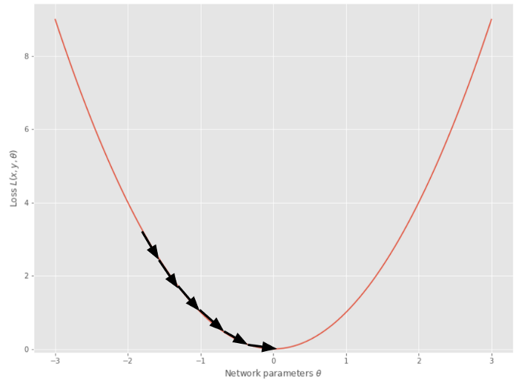
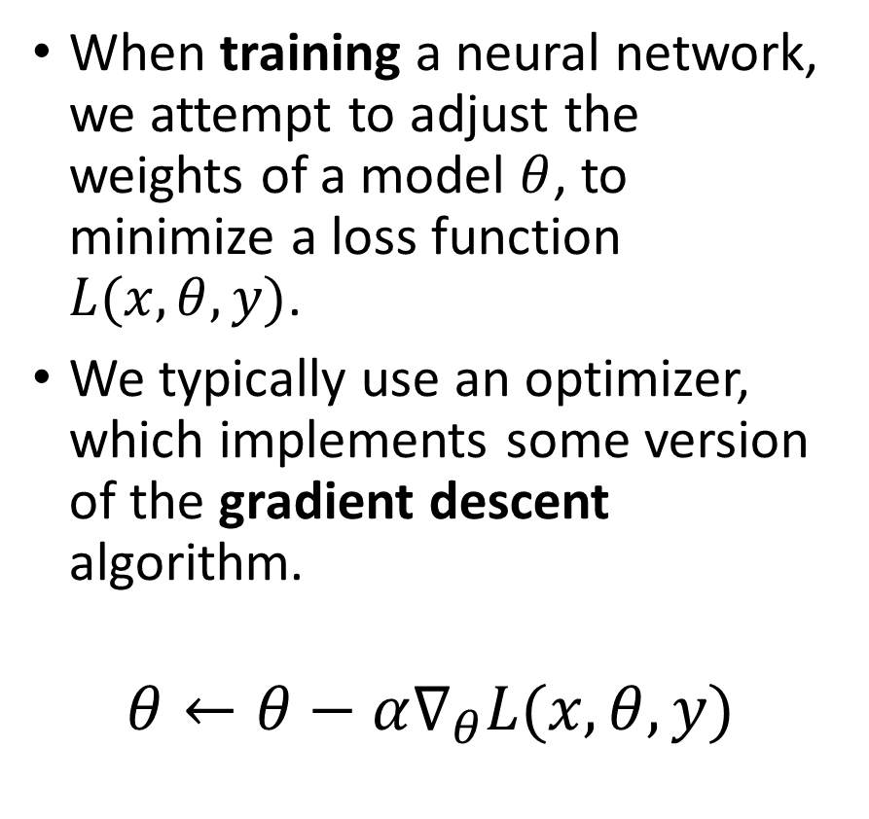
A reminder on gradient descent
When training a neural network, we attempt to adjust the weights of a model $θ$, to minimize a loss function $L(x, θ, y)$.
We typically use an optimizer, which implements some version of the gradient descent algorithm.
$$θ←θ−α∇_{θ}L(x, θ, y)$$
In a sense, gradients tell us how to improve the model performance by adjusting its parameters meaningfully.

Slide 12
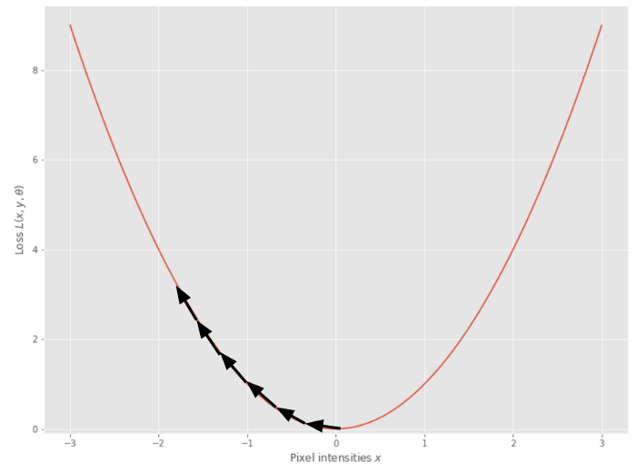
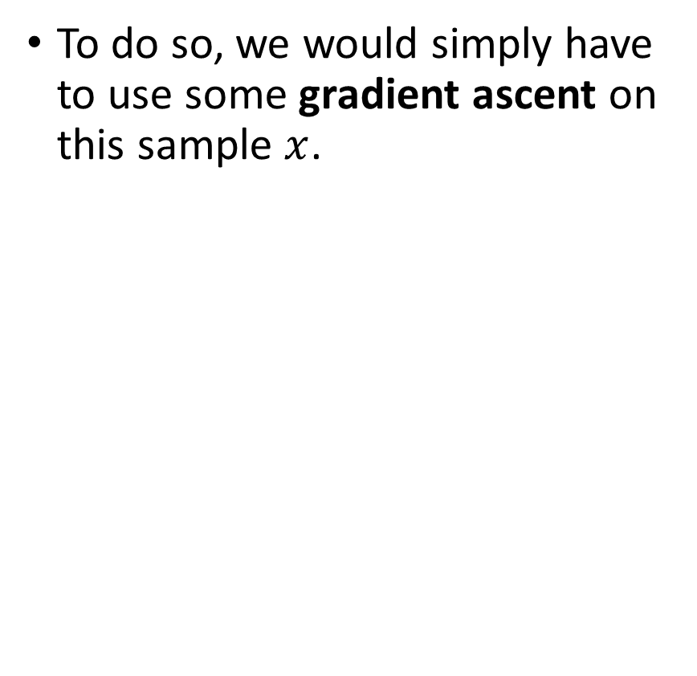
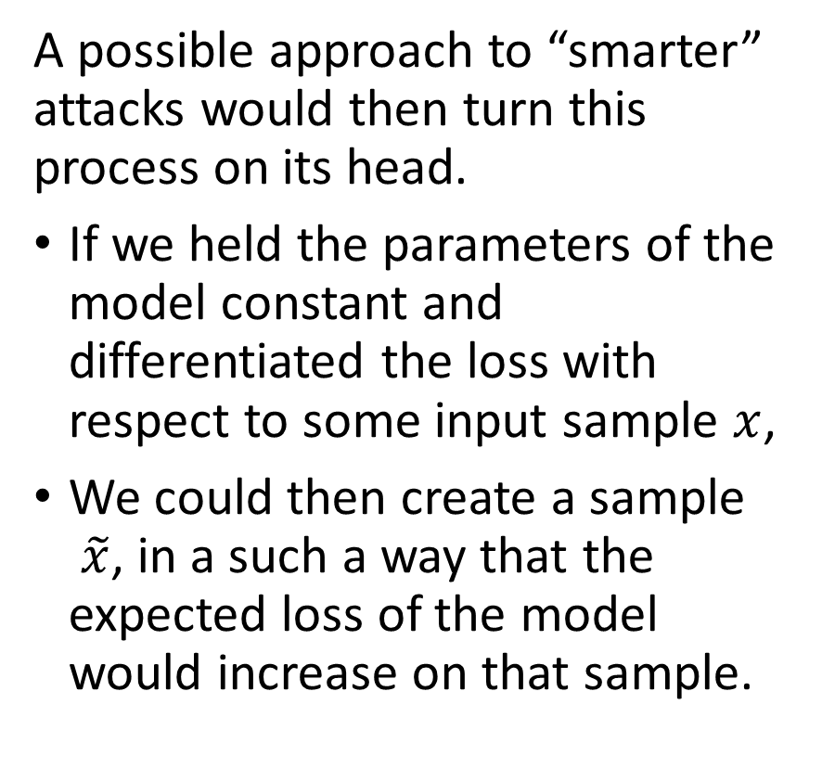
Using Gradient Ascent to Attack
A possible approach to “smarter” attacks would then turn this process on its head.
If we held the parameters of the model constant and differentiated the loss with respect to some input sample $x$,
We could then create a sample $\tilde{x}$, in a such a way that the expected loss of the model would increase on that sample.
To do so, we would simply have to use some gradient ascent on this sample $x$.

Slide 13
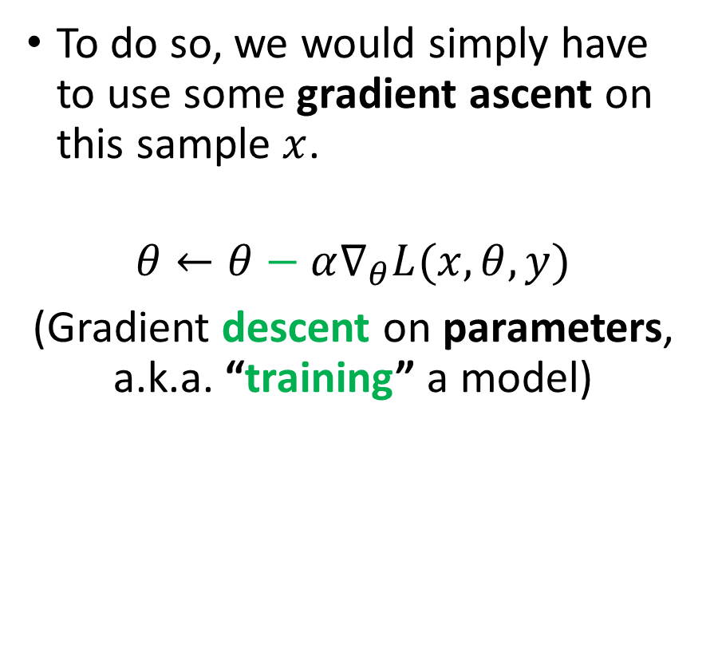
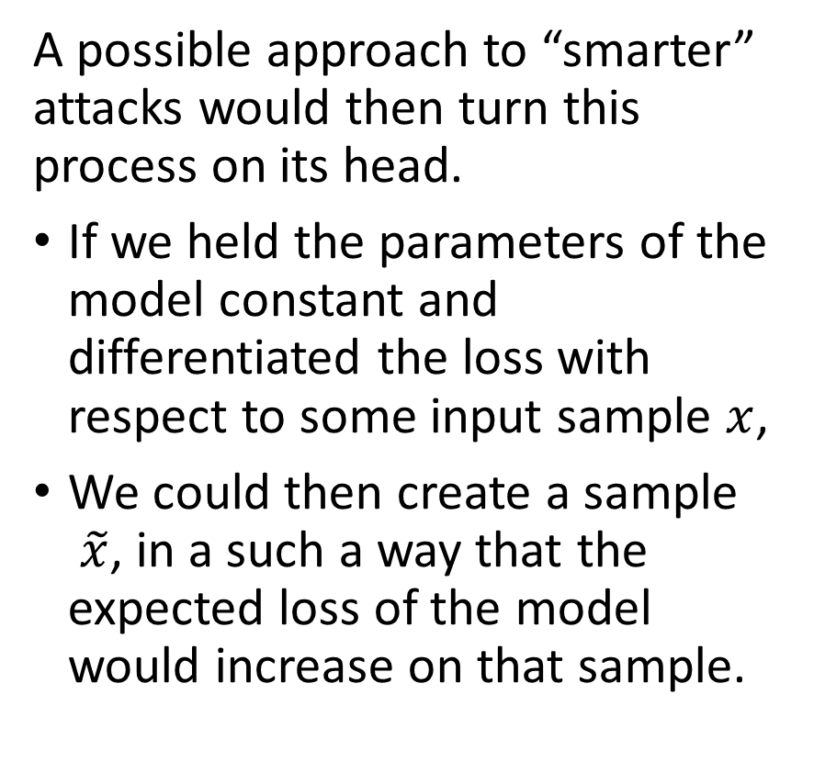
Using Gradient Ascent to Attack
A possible approach to “smarter” attacks would then turn this process on its head.
If we held the parameters of the model constant and differentiated the loss with respect to some input sample $x$,
We could then create a sample $\tilde{x}$, in a such a way that the expected loss of the model would increase on that sample.
To do so, we would simply have to use some gradient ascent on this sample $x$.
$$θ←θ−α∇_{θ}L(x, θ, y)$$
(Gradient descent on parameters, a.k.a. “training” a model)

Slide 14
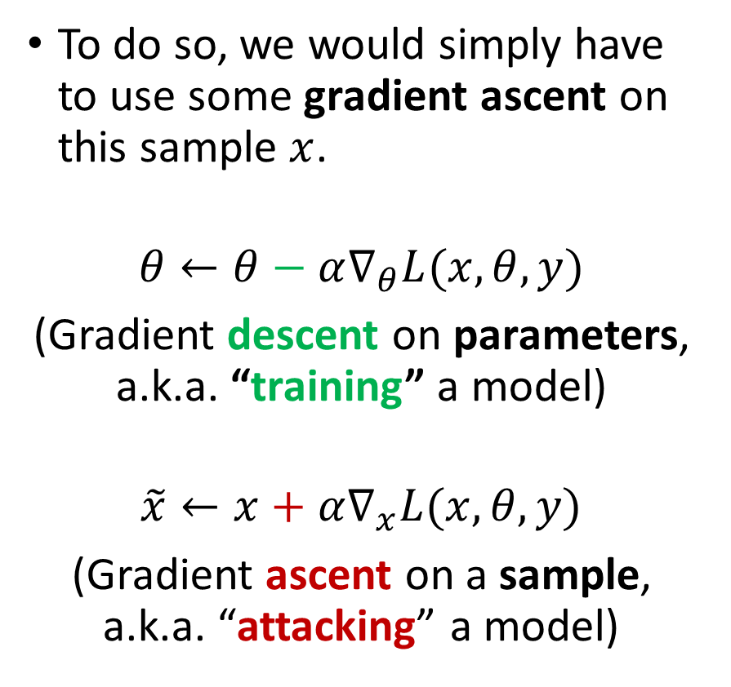
Using Gradient Ascent to Attack
A possible approach to “smarter” attacks would then turn this process on its head.
If we held the parameters of the model constant and differentiated the loss with respect to some input sample $x$,
We could then create a sample $\tilde{x}$, in a such a way that the expected loss of the model would increase on that sample.
To do so, we would simply have to use some gradient ascent on this sample $x$.
$$θ←θ−α∇_{θ}L(x, θ, y)$$
(Gradient descent on parameters, a.k.a. “training” a model)
$$\tilde{x}←x+α∇_{x}L(x, θ, y)$$
(Gradient ascent on a sample, a.k.a. “attacking” a model)

Slide 15
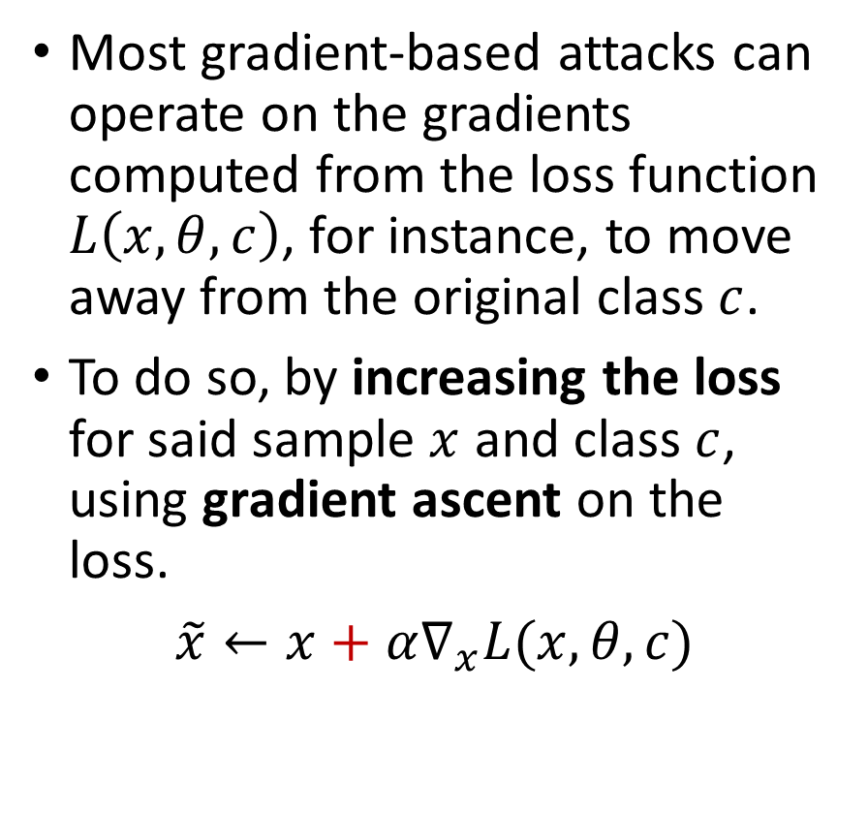
A note on losses, softmax and gradients
Most gradient-based attacks can operate on the gradients computed from the loss function $L\left(x, θ, c\right)$, for instance, to move away from the original class $c$.
To do so, by increasing the loss for said sample $x$ and class $c$, using gradient ascent on the loss.
$\tilde{x}←x+α∇_{x}L(x, θ, c)$

Slide 16
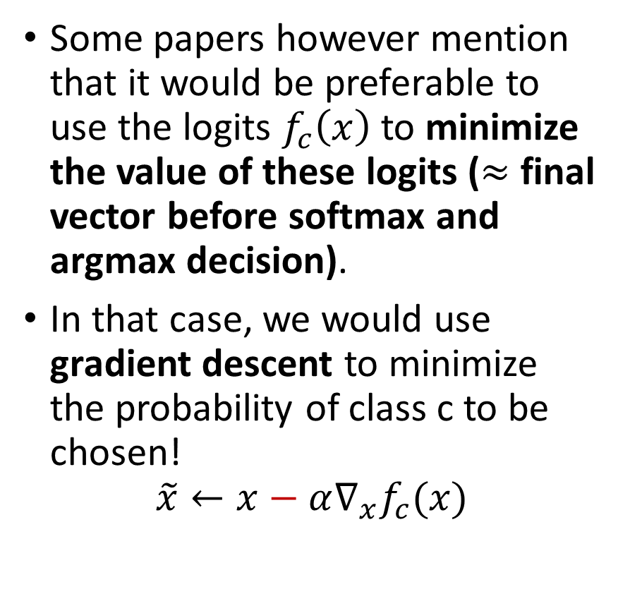
A note on losses, softmax and gradients
Some papers however mention that it would be preferable to use the logits $f_{c}\left(x\right)$to minimize the value of these logits ($≈$ final vector before softmax and argmax decision).
In that case, we would use gradient descent to minimize the probability of class c to be chosen!
$$\tilde{x}←x−α∇_{x}f_{c}(x)$$
Note: this second approach (logits) often works better, because of the softmax might end up messing up the gradients sometimes.

Slide 17
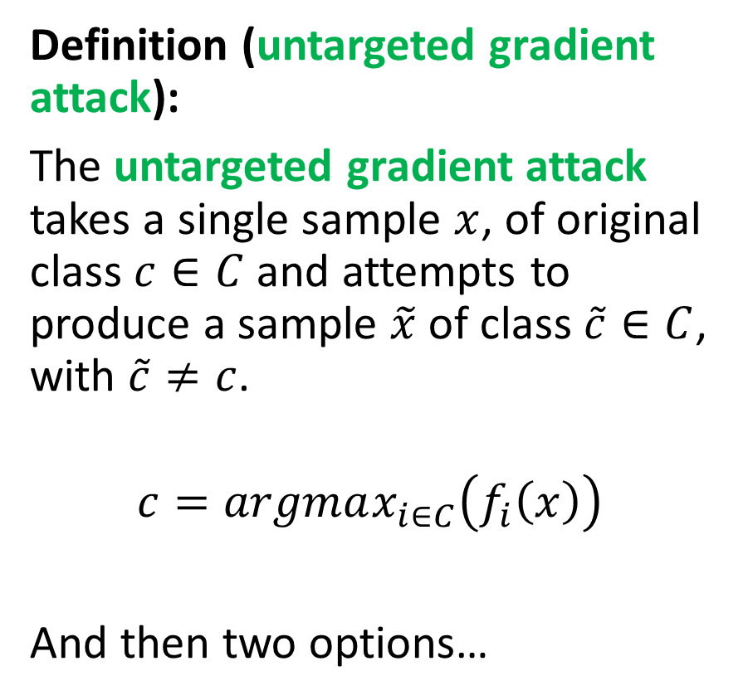
Untargeted Gradient Attack
Definition (untargeted gradient attack):
The untargeted gradient attack takes a single sample $x$, of original class $c∈C$ and attempts to produce a sample $\tilde{x}$ of class $\tilde{c}∈C$, with $\tilde{c}≠c$.
$$c=argmax_{i∈C}\left(f_{i}\left(x\right)\right)$$
And then two options…

Slide 18
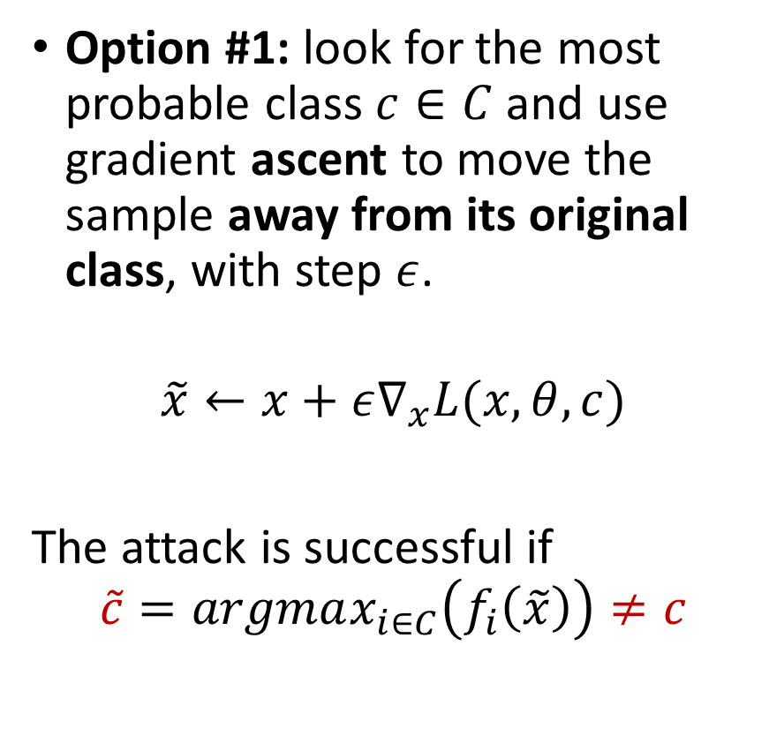
Untargeted Gradient Attack (option #1)
Definition (untargeted gradient attack):
The untargeted gradient attack takes a single sample $x$, of original class $c∈C$ and attempts to produce a sample $\tilde{x}$ of class $\tilde{c}∈C$, with $\tilde{c}≠c$.
$$c=argmax_{i∈C}\left(f_{i}\left(x\right)\right)$$
And then two options…
Option #1: look for the most probable class $c∈C$ and use gradient ascent to move the sample away from its original class, with step $ε$.
$$\tilde{x}←x+ε∇_{x}L(x, θ, c)$$
The attack is successful if
$$\tilde{c}=argmax_{i∈C}\left(f_{i}\left(\tilde{x}\right)\right)≠c$$

Slide 19
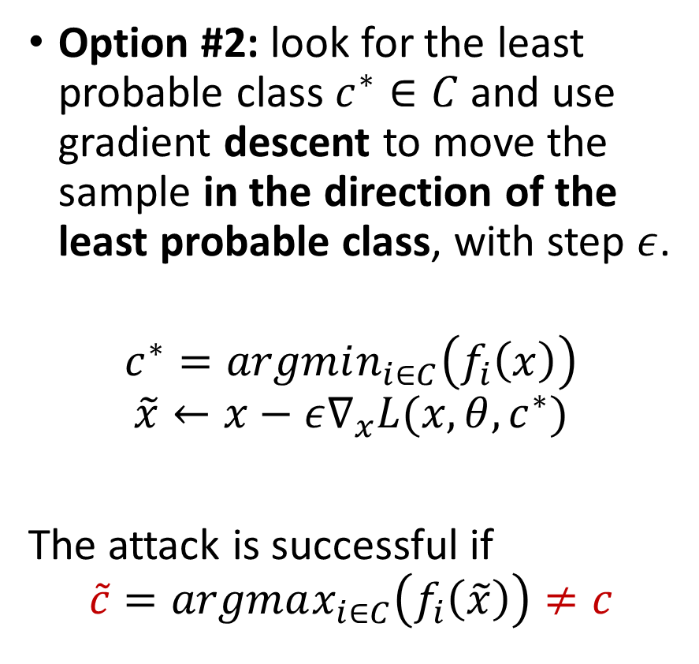
Untargeted Gradient Attack (option #2, not implemented in notebooks)
Definition (untargeted gradient attack):
The untargeted gradient attack takes a single sample $x$, of original class $c∈C$ and attempts to produce a sample $\tilde{x}$ of class $\tilde{c}∈C$, with $\tilde{c}≠c$.
$$c=argmax_{i∈C}\left(f_{i}\left(x\right)\right)$$
And then two options…
Option #2: look for the least probable class $c^{∗}∈C$ and use gradient descent to move the sample in the direction of the least probable class, with step $ε$.
$$c^{∗}=argmin_{i∈C}\left(f_{i}\left(x\right)\right)$$
$$\tilde{x}←x−ε∇_{x}L(x, θ, c^{∗})$$
The attack is successful if
$$\tilde{c}=argmax_{i∈C}\left(f_{i}\left(\tilde{x}\right)\right)≠c$$

Slide 20
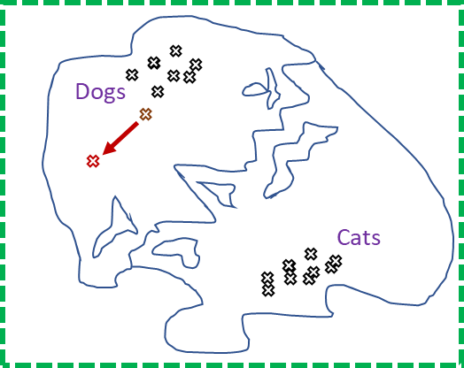
Why gradient attack works better than randomly noising
When randomly noising a sample to make an attack sample, we move randomly in the feature map.

Slide 21
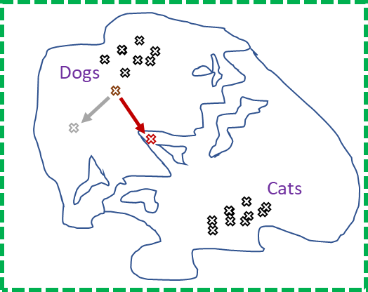
Why gradient attack works better than randomly noising
When randomly noising a sample to make an attack sample, we move randomly in the feature map.
When using gradient attack, we move in a more meaningful direction, which might help our original sample become misclassified.

Slide 22
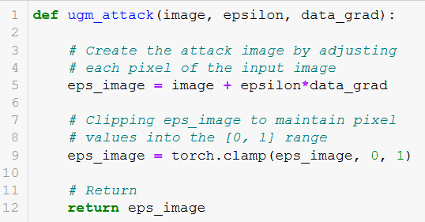
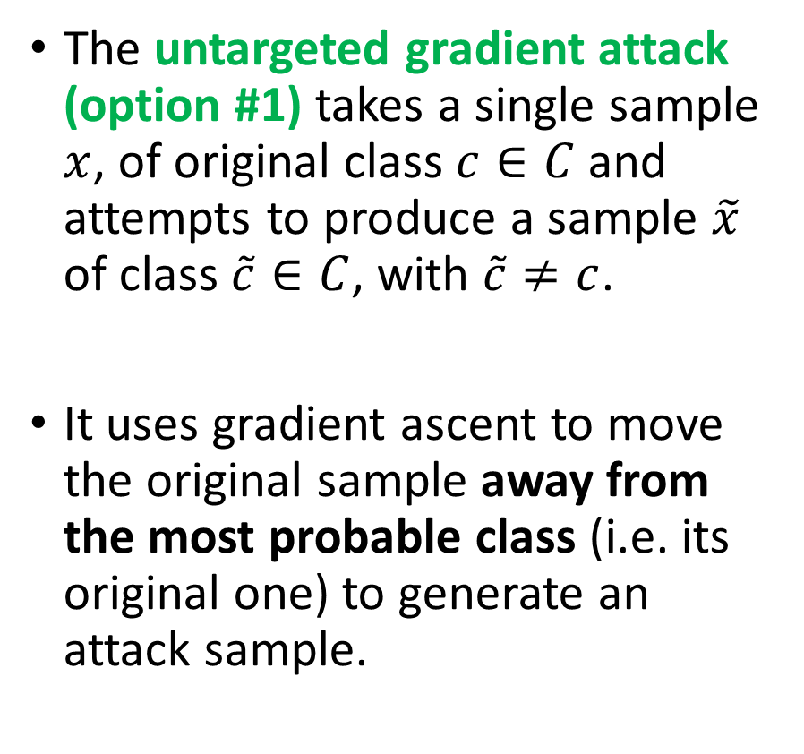

Untargeted gradient attack code
The untargeted gradient attack (option #1) takes a single sample $x$, of original class $c∈C$ and attempts to produce a sample $\tilde{x}$ of class $\tilde{c}∈C$, with $\tilde{c}≠c$.
It uses gradient ascent to move the original sample away from the most probable class (i.e. its original one) to generate an attack sample.
Line 5 easily implements $$\tilde{x}←x+ε∇_{x}L(x, θ, c)$$
(Taken from notebook 2.)

Slide 23
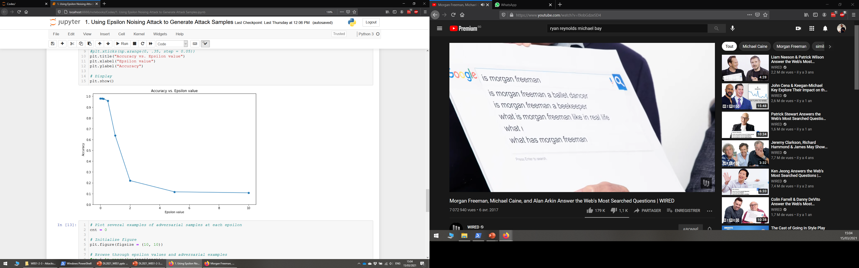
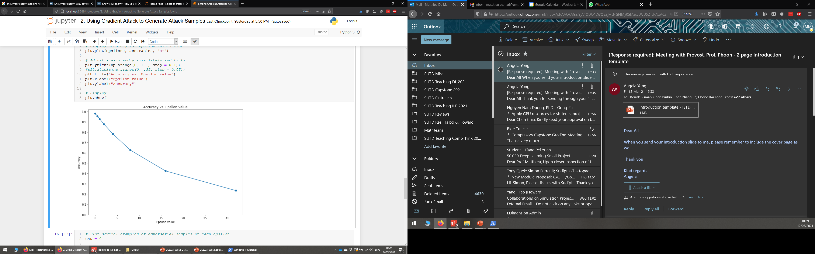
Untargeted gradient vs. epsilon noising
Epsilon Noising Method
Untargeted Gradient Method

Slide 24
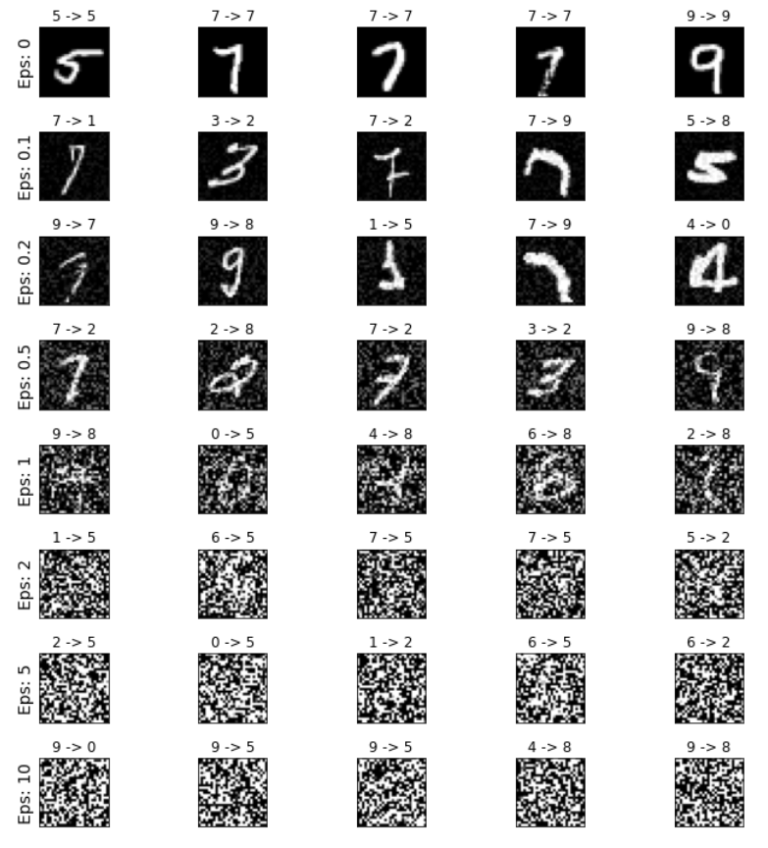
Untargeted gradient vs. epsilon noising
Epsilon Noising Method
Untargeted Gradient Method

Slide 25
Untargeted gradient vs. epsilon noising
Epsilon Noising Method
Untargeted Gradient Method

Slide 26
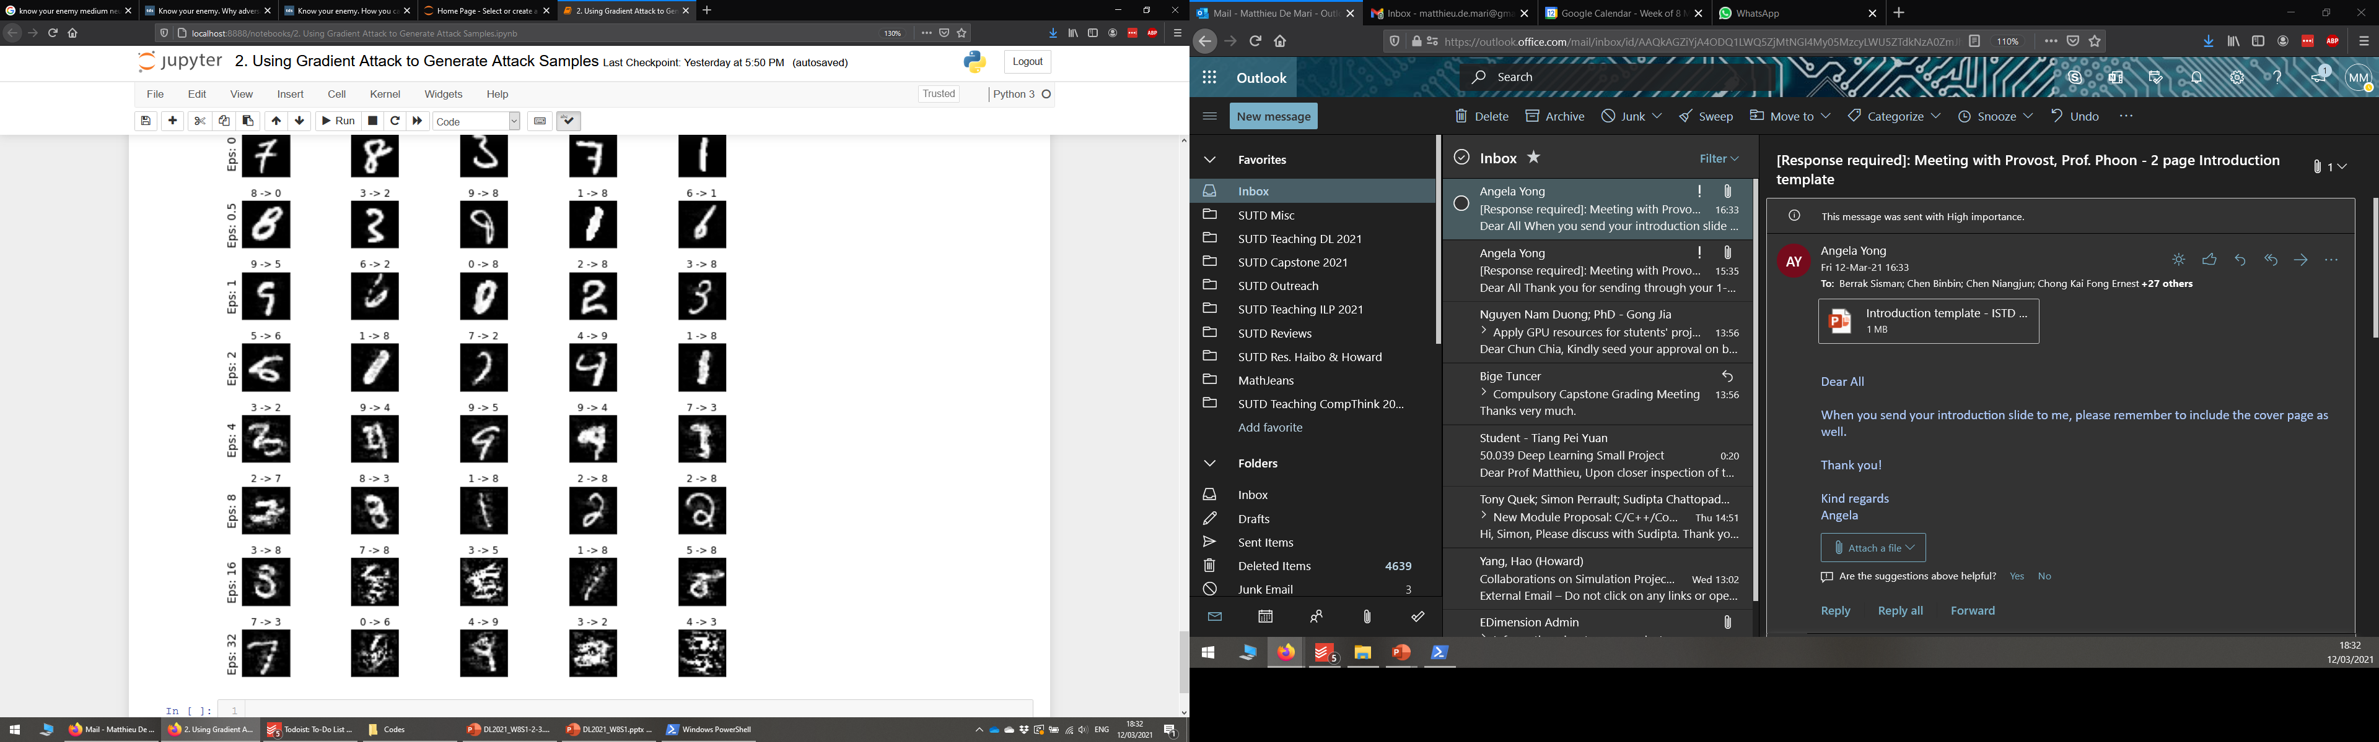
Untargeted gradient vs. epsilon noising
Epsilon Noising Method
Untargeted Gradient Method

Slide 27
Untargeted gradient vs. epsilon noising
Epsilon Noising Method
Untargeted Gradient Method

Slide 28
Untargeted gradient vs. epsilon noising
Epsilon Noising Method
Untargeted Gradient Method
Untargeted Gradient attack is unsuccessful 77% of the time. (somewhat better)
ENM attack is unsuccessful 92% of the time.

Slide 29
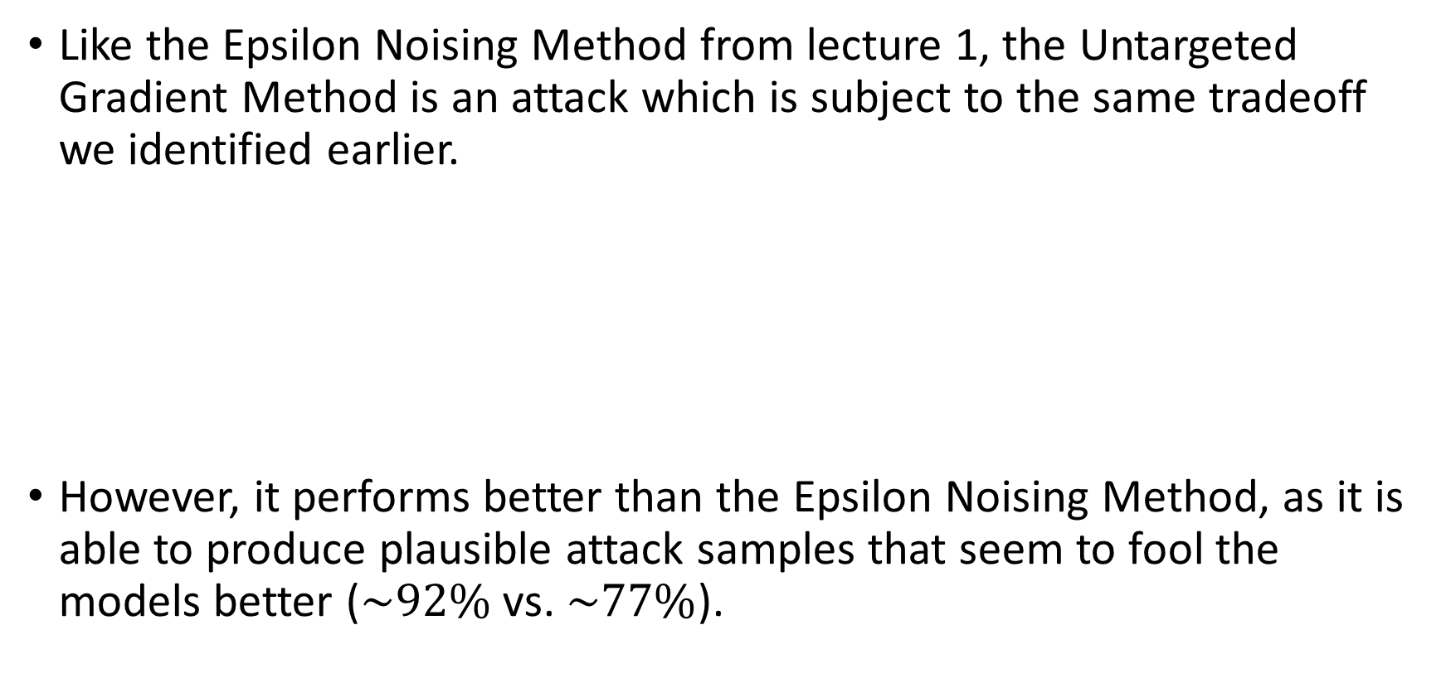
Untargeted gradient attack recap
Like the Epsilon Noising Method from lecture 1, the Untargeted Gradient Method is an attack which is subject to the same tradeoff we identified earlier.
However, it performs better than the Epsilon Noising Method, as it is able to produce plausible attack samples that seem to fool the models better ($\sim 92\%$ vs. $\sim 77\%$).
Attack sample efficacy
Attack sample plausibility
vs.

Slide 30
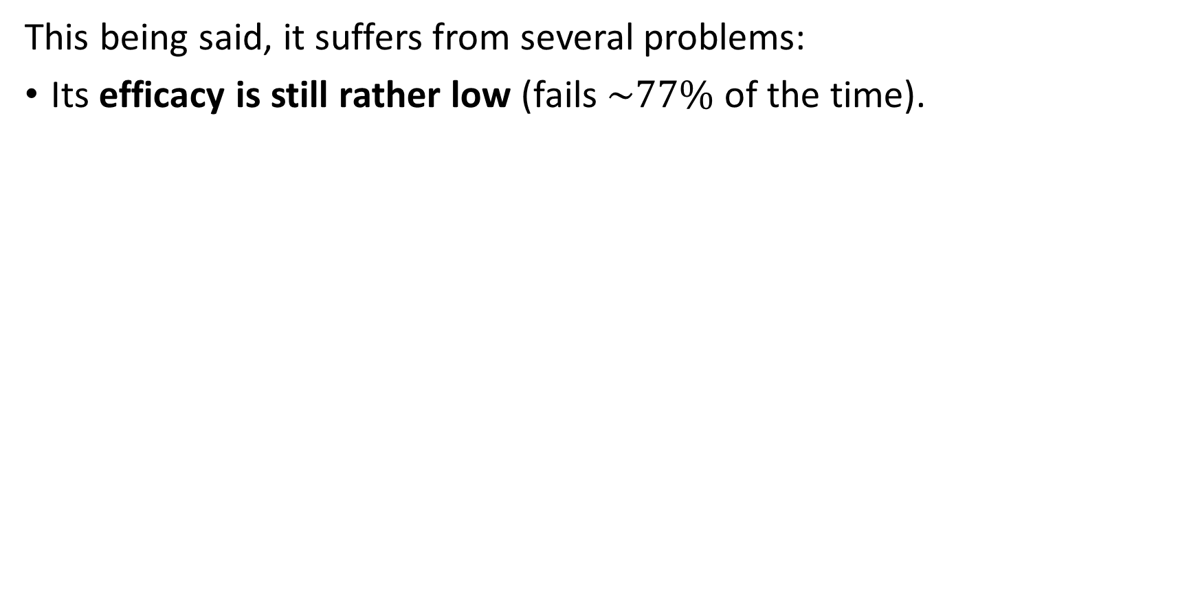
Untargeted gradient attack recap
This being said, it suffers from several problems:
Its efficacy is still rather low (fails $\sim 77\%$of the time).

Slide 31
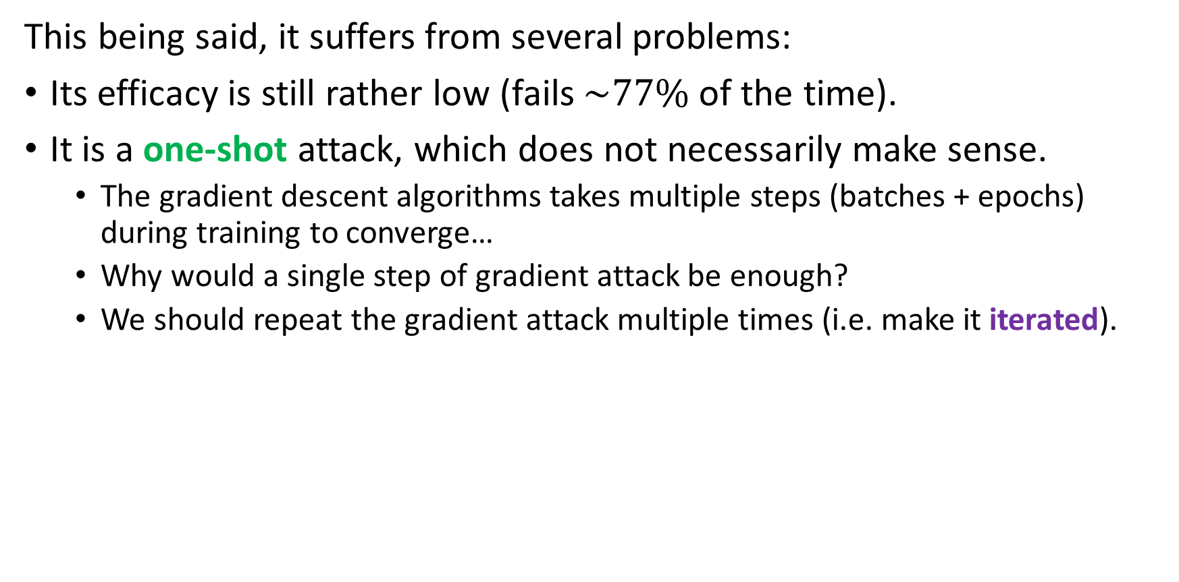
Untargeted gradient attack recap
This being said, it suffers from several problems:
Its efficacy is still rather low (fails $\sim 77\%$of the time).
It is a one-shot attack, which does not necessarily make sense.
The gradient descent algorithms takes multiple steps (batches + epochs) during training to converge…
Why would a single step of gradient attack be enough?
We should repeat the gradient attack multiple times (i.e. make it iterated).

Slide 32
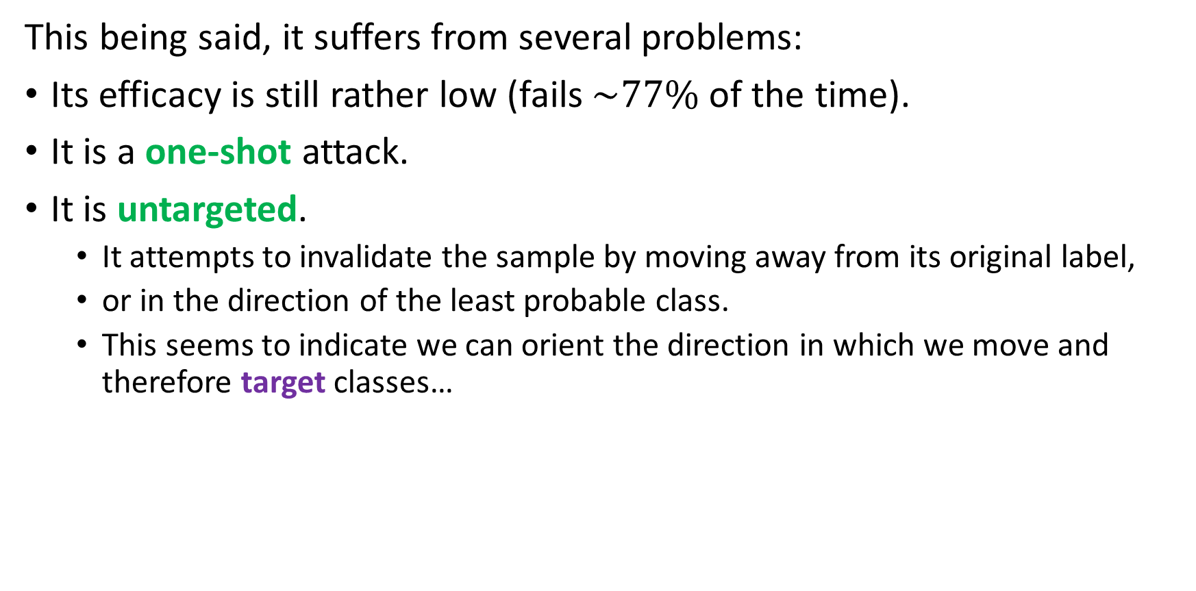
Untargeted gradient attack recap
This being said, it suffers from several problems:
Its efficacy is still rather low (fails $\sim 77\%$of the time).
It is a one-shot attack.
It is untargeted.
It attempts to invalidate the sample by moving away from its original label,
or in the direction of the least probable class.
This seems to indicate we can orient the direction in which we move and therefore target classes…

Slide 33
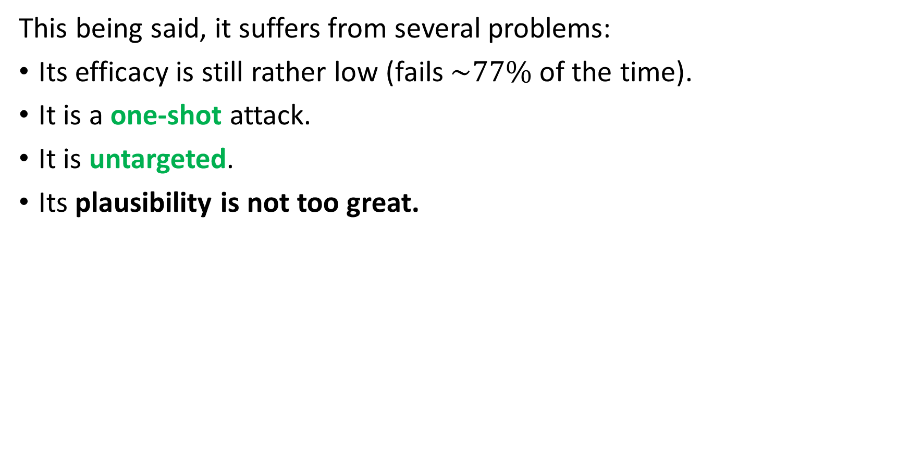
Untargeted gradient attack recap
This being said, it suffers from several problems:
Its efficacy is still rather low (fails $\sim 77\%$of the time).
It is a one-shot attack.
It is untargeted.
Its plausibility is not too great.

Slide 34
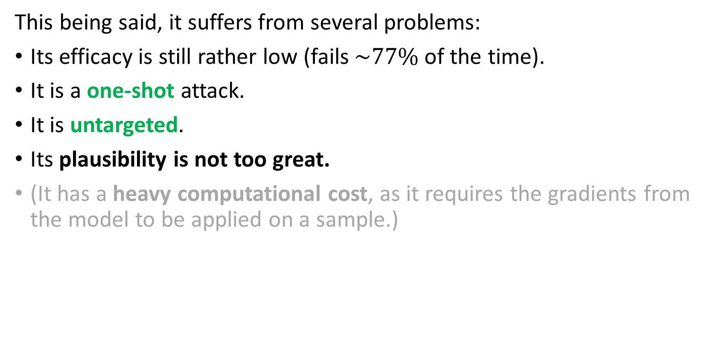
Untargeted gradient attack recap
This being said, it suffers from several problems:
Its efficacy is still rather low (fails $\sim 77\%$of the time).
It is a one-shot attack.
It is untargeted.
Its plausibility is not too great.
(It has a heavy computational cost, as it requires the gradients from the model to be applied on a sample.)

Slide 35
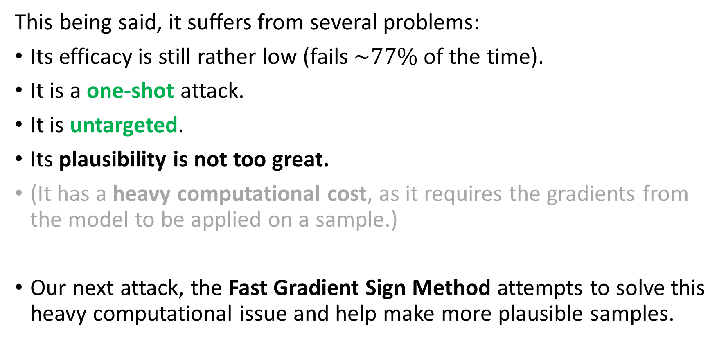
Untargeted gradient attack recap
This being said, it suffers from several problems:
Its efficacy is still rather low (fails $\sim 77\%$of the time).
It is a one-shot attack.
It is untargeted.
Its plausibility is not too great.
(It has a heavy computational cost, as it requires the gradients from the model to be applied on a sample.)
Our next attack, the Fast Gradient Sign Method attempts to solve this heavy computational issue and help make more plausible samples.

Slide 36
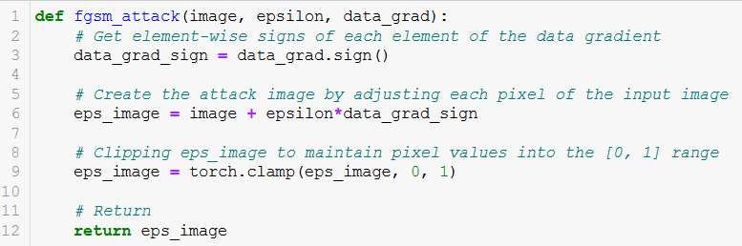
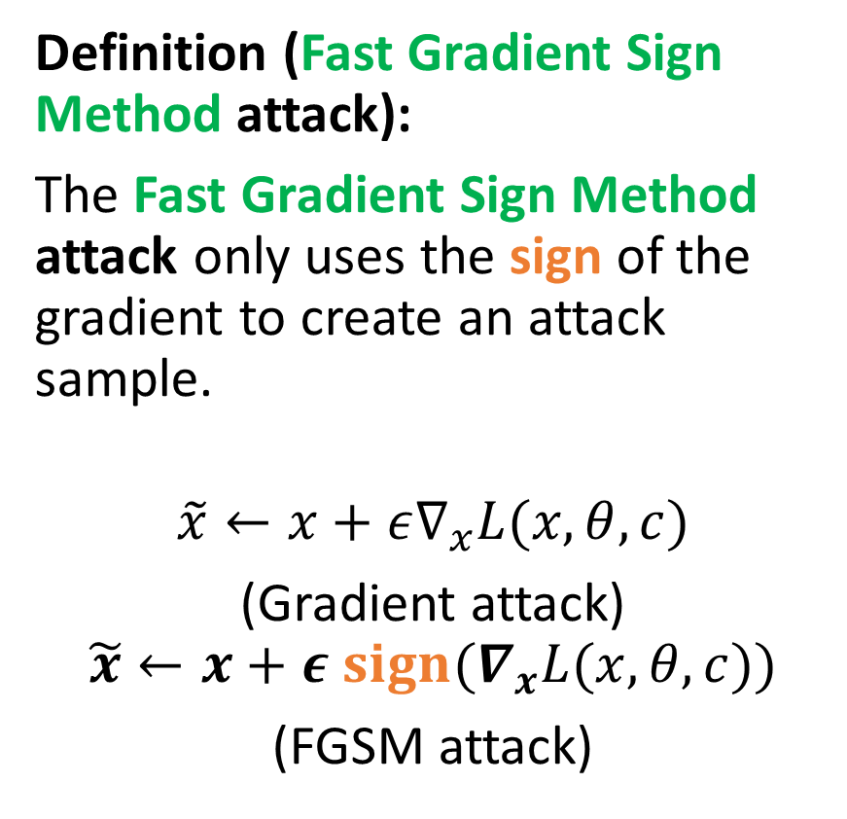
Fast Gradient Sign Method (FGSM)
Definition (Fast Gradient Sign Method attack):
The Fast Gradient Sign Method attack only uses the sign of the gradient to create an attack sample.
$$\tilde{x}←x+ε∇_{x}L(x, θ, c)$$
(Gradient attack)
$$\tilde{x}←x+ε {sign(∇}_{x}L(x, θ, c))$$
(FGSM attack)

Slide 37
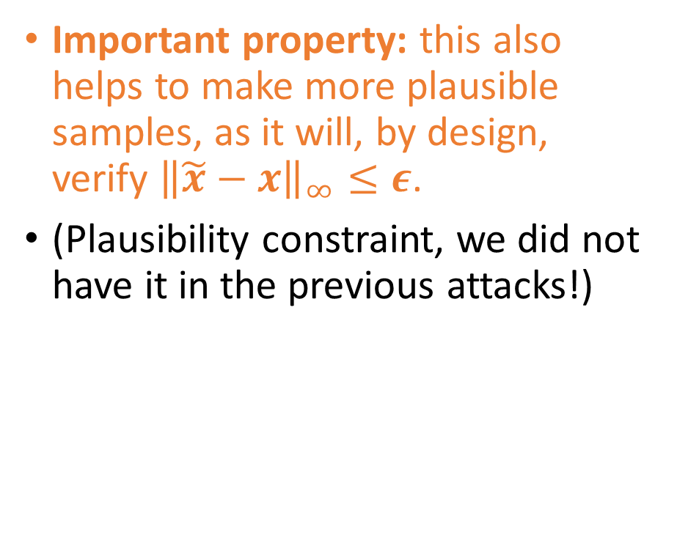
Fast Gradient Sign Method (FGSM)
Definition (Fast Gradient Sign Method attack):
The Fast Gradient Sign Method attack only uses the sign of the gradient to create an attack sample.
$$\tilde{x}←x+ε∇_{x}L(x, θ, c)$$
(Gradient attack)
$$\tilde{x}←x+ε {sign(∇}_{x}L(x, θ, c))$$
(FGSM attack)
Important property: this also helps to make more plausible samples, as it will, by design, verify ${\left\|\tilde{x}−x\right\|}_{∞}≤ε$.
(Plausibility constraint, we did not have it in the previous attacks!)

Slide 38
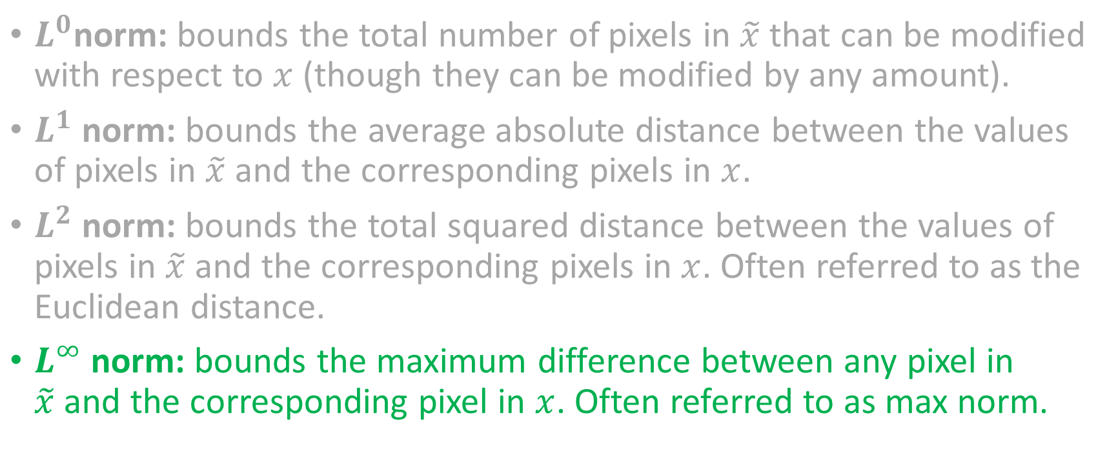
A reminder about norms
$L^{0}$norm: bounds the total number of pixels in $\tilde{x}$ that can be modified with respect to $x$ (though they can be modified by any amount).
$L^{1}$ norm: bounds the average absolute distance between the values of pixels in $\tilde{x}$and the corresponding pixels in $x$.
$L^{2}$ norm: bounds the total squared distance between the values of pixels in $\tilde{x}$and the corresponding pixels in $x$. Often referred to as the Euclidean distance.
$L^{∞}$norm: bounds the maximum difference between any pixel in $\tilde{x}$and the corresponding pixel in $x$. Often referred to as max norm.
Preferred one!
$${\left\|\tilde{x}−x\right\|}_{∞}=\max_{i,j}\left(\left|{\tilde{x}}_{i,j}−x_{i,j}\right|\right)$$

Slide 39
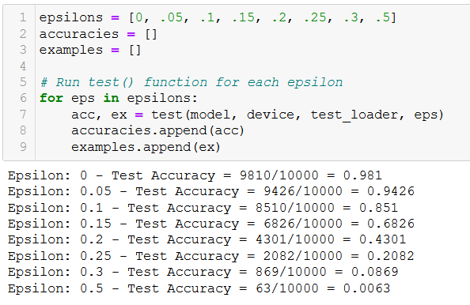
Testing the FGSM attack
The FGSM attack works just fine, and it might even make the model completely malfunction!
In the noising approach, the model had to guess randomly and ended up getting a 10% accuracy for large values of epsilon.
Here, the FGSM will strongly push the model to malfunction, eventually leading to a 0% accuracy.
From Notebook 3.

Slide 40
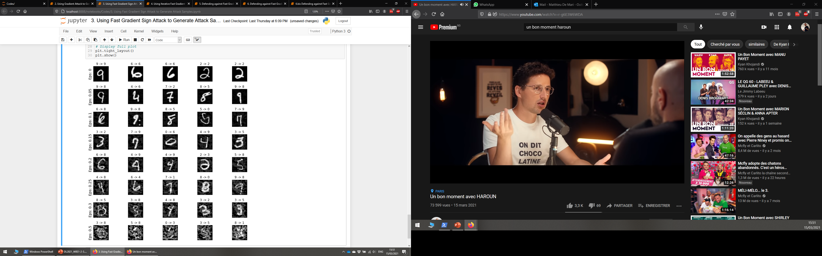
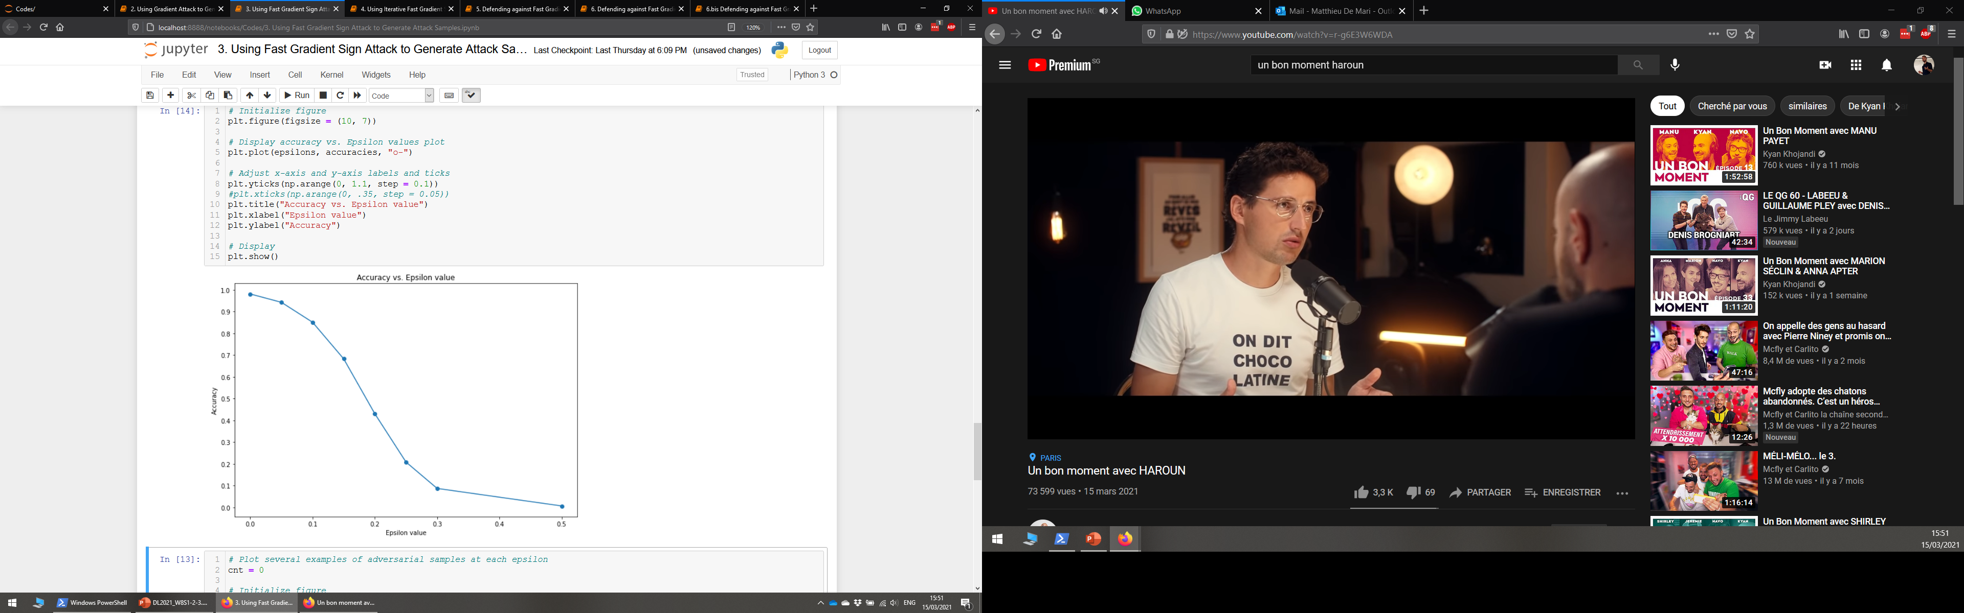
Testing the FGSM attack

Slide 41
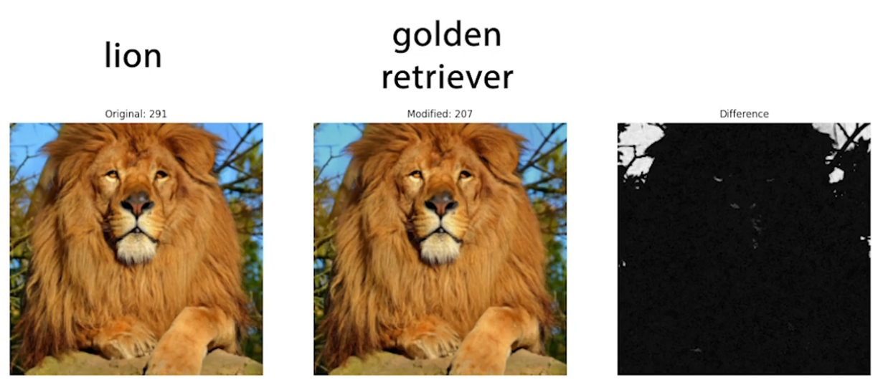

Slide 42
Background pixels were changed and this lead to an entire different classification result?! This indicates that our model probably has a wrong classification logic somewhere…
From [Goodfellow2015].

Slide 43
Some more taxonomy on attacks
Definition (iterated attack):
An iterated attack attempts to produce an attack sample, like the one-shot attacks.
However, it will try to adjust the said sample until it either
makes the model malfunction in an expected way,
or reaches a maximal number of allowed iterations.
The iterated attacks are often more robust and efficient.
Definition (one-shot attack):
A one-shot attack attempts to produce a single attack sample, and if this attack fails, it simply retries on a different sample.
Noising was therefore a one-shot attack. It attempted to noise a sample to have it misclassified.
However, if this attempt failed, it simply tried on another sample.

Slide 44
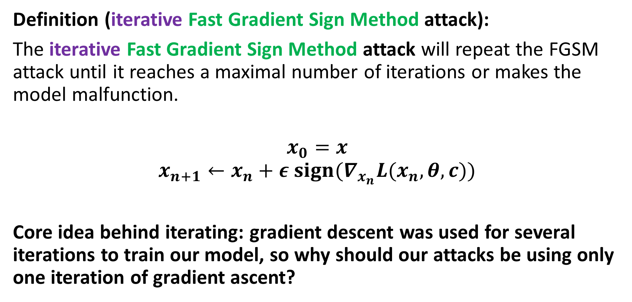
Iterative FGSM attack (from [Kurakin2016])
Definition (iterative Fast Gradient Sign Method attack):
The iterative Fast Gradient Sign Method attack will repeat the FGSM attack until it reaches a maximal number of iterations or makes the model malfunction.
$$x_{0}=x$$
$$x_{n+1}←x_{n}+ε {sign(∇}_{x_{n}}L(x_{n}, θ, c))$$
Core idea behind iterating: gradient descent was used for several iterations to train our model, so why should our attacks be using only one iteration of gradient ascent?

Slide 45
Some more taxonomy on attacks
Definition (untargeted attack):
The objective of an untargeted attack is to produce an attack sample, which will simply be misclassified.
Noising was an untargeted attack, as we attempted to modify a sample in such a way that it would classified as anything but its ground truth label.
Definition (targeted attack):
The objective of a targeted attack is to produce an attack sample, which will be misclassified as a specific class.
As such, targeted attacks are often more complex than untargeted ones.
E.g., modify a picture of a dog (original label), so it is misclassified as a cat (target label).

Slide 46
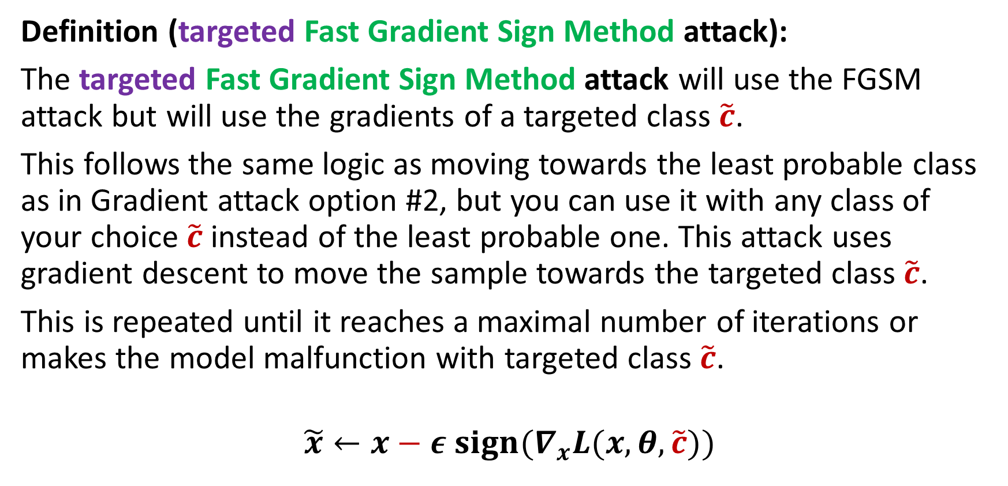
Targeted FGSM attack
Definition (targeted Fast Gradient Sign Method attack):
The targeted Fast Gradient Sign Method attack will use the FGSM attack but will use the gradients of a targeted class $\tilde{c}$.
This follows the same logic as moving towards the least probable class as in Gradient attack option #2, but you can use it with any class of your choice $\tilde{c}$ instead of the least probable one. This attack uses gradient descent to move the sample towards the targeted class $\tilde{c}$.
This is repeated until it reaches a maximal number of iterations or makes the model malfunction with targeted class $\tilde{c}$.
$$\tilde{x}←x−ε {sign(∇}_{x}L(x, θ,\tilde{c}))$$

Slide 47
Untargeted gradient attack recap
This being said, it suffers from several problems:
Its efficacy is still rather low (fails $\sim 77\%$of the time).
It is a one-shot attack.
It is untargeted.
Its plausibility is not too great.
(It has a heavy computational cost, as it requires the gradients from the model to be applied on a sample.)

Slide 48
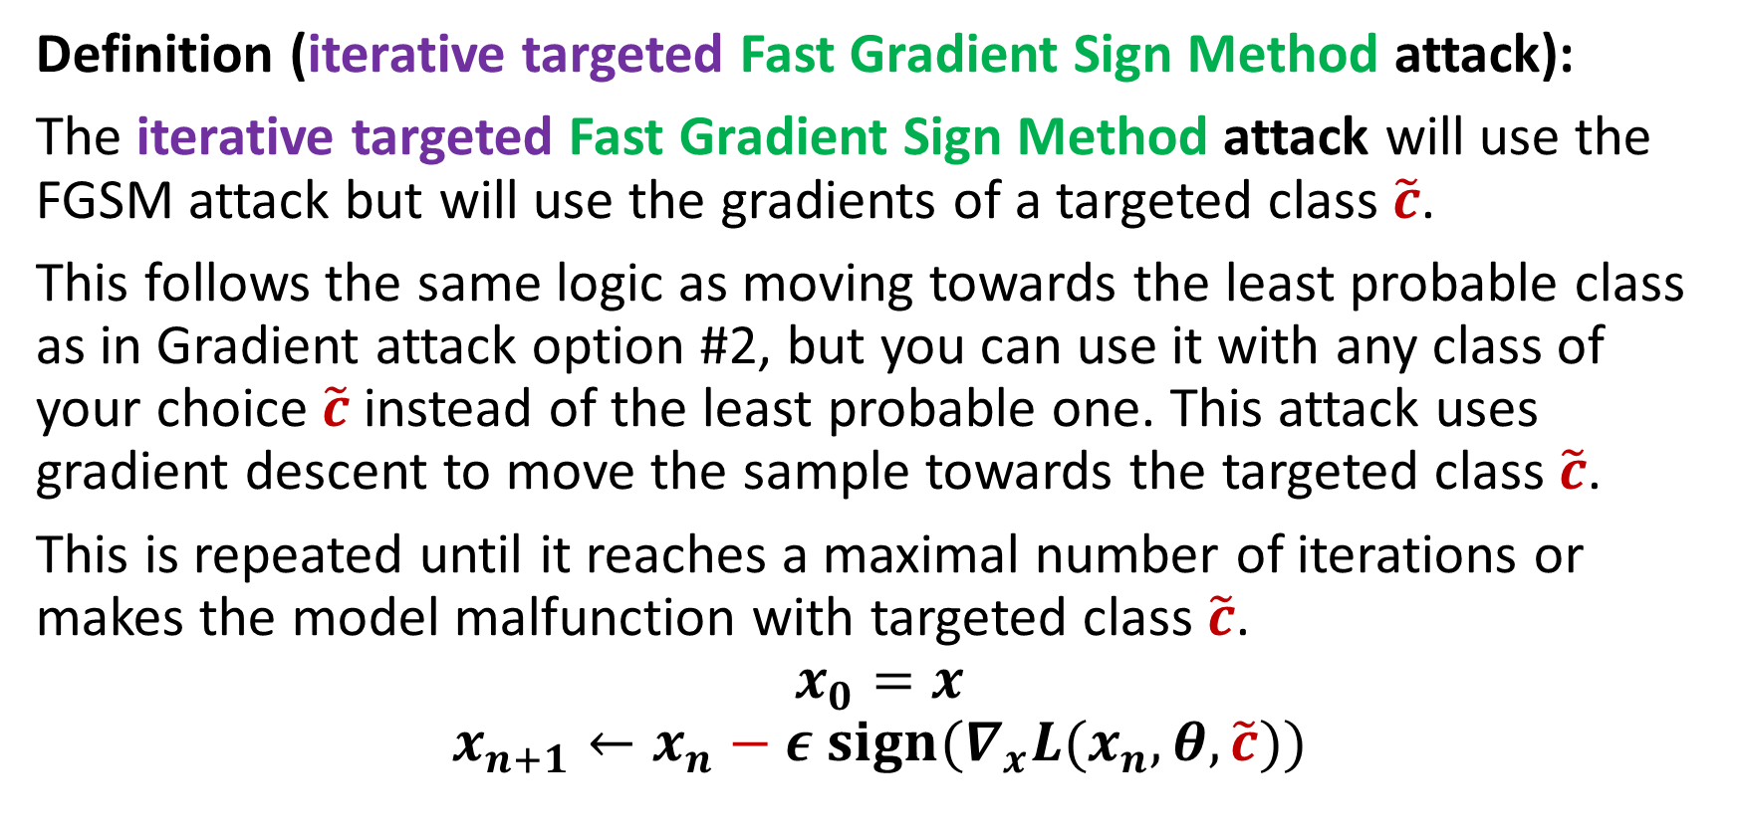
Iterative and Targeted FGSM attack
Definition (iterative targeted Fast Gradient Sign Method attack):
The iterative targeted Fast Gradient Sign Method attack will use the FGSM attack but will use the gradients of a targeted class $\tilde{c}$.
This follows the same logic as moving towards the least probable class as in Gradient attack option #2, but you can use it with any class of your choice $\tilde{c}$ instead of the least probable one. This attack uses gradient descent to move the sample towards the targeted class $\tilde{c}$.
This is repeated until it reaches a maximal number of iterations or makes the model malfunction with targeted class $\tilde{c}$.
$$x_{0}=x$$
$$x_{n+1}←x_{n}−ε {sign(∇}_{x}L(x_{n}, θ,\tilde{c}))$$

Slide 49
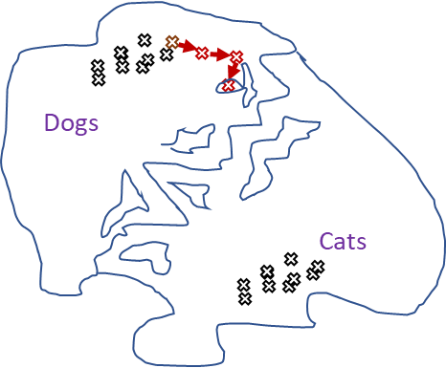
Why gradient attack works better than randomly noising
When randomly noising a sample to make an attack sample, we move randomly in the feature map.
When using a gradient-type attack, we move in a more meaningful direction, which might help our original sample become misclassified.
Iterating allows for smaller steps and better plausibility in general (smaller changes in original image).

Slide 50
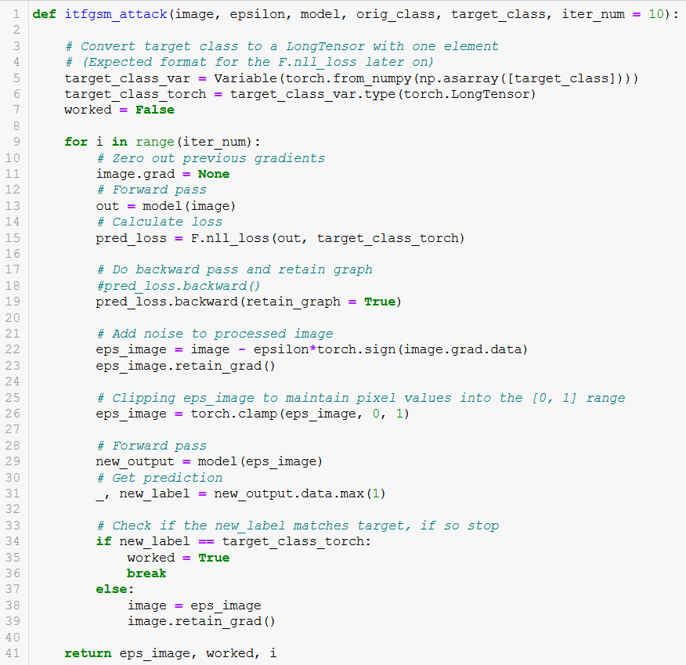
From Notebook 4.

Slide 51
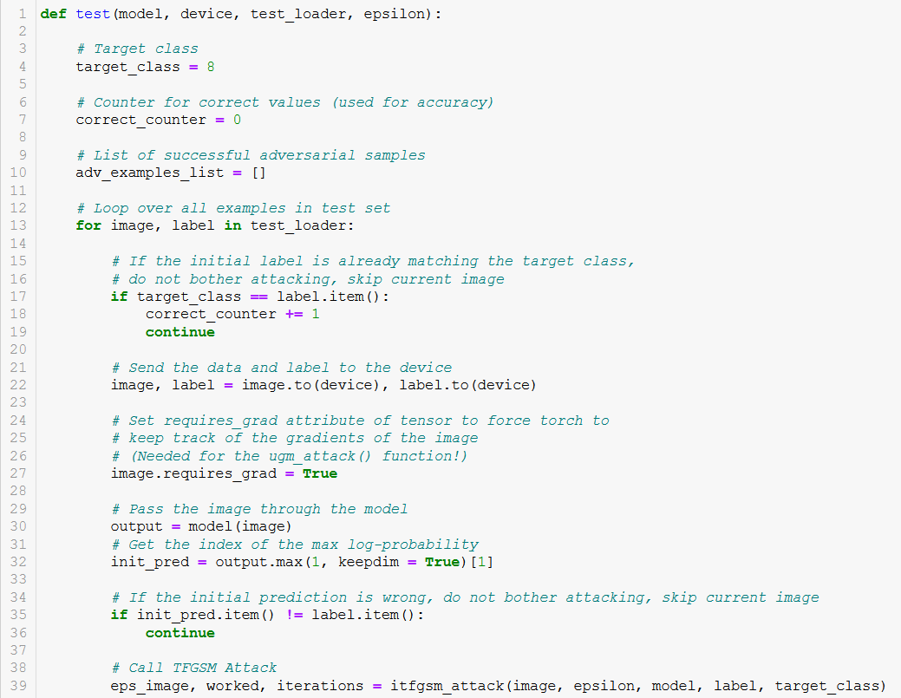
Testing the ITFGSM attack
If sample is already of the target class, attack cannot happen…
We cannot modify a picture of an 8 so that it becomes misclassified as an 8! Skip these.

Slide 52
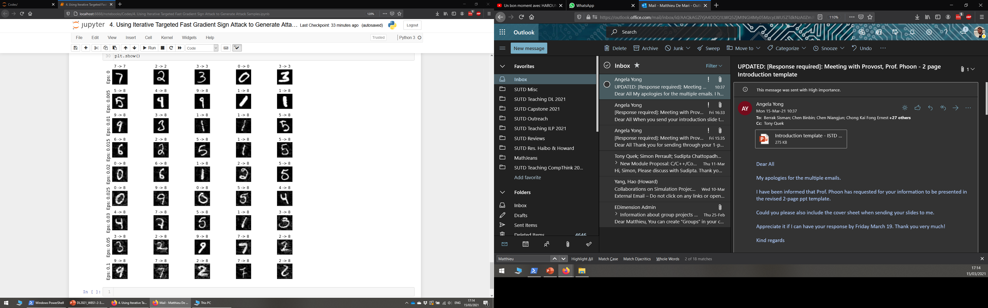
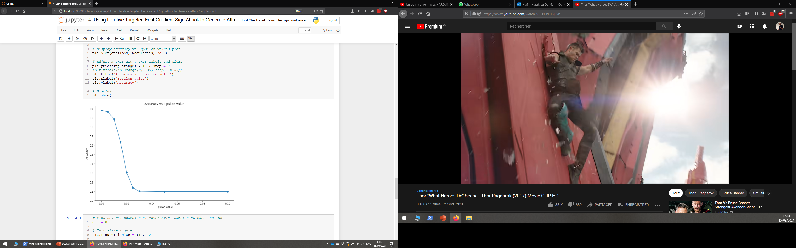
Testing the ITFGSM attack
Original class of the samples → New class given by classifier to generated attack sample

Slide 53
Testing the ITFGSM attack
All these samples are now misclassified as 8s!
(And they look rather plausible, on top of that!)

Slide 54
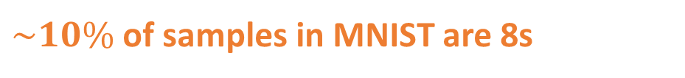
Testing the ITFGSM attack
All these samples are now misclassified as 8s!
(And they look rather plausible, on top of that!)
$\sim 10\%$of samples in MNIST are 8s

Slide 55
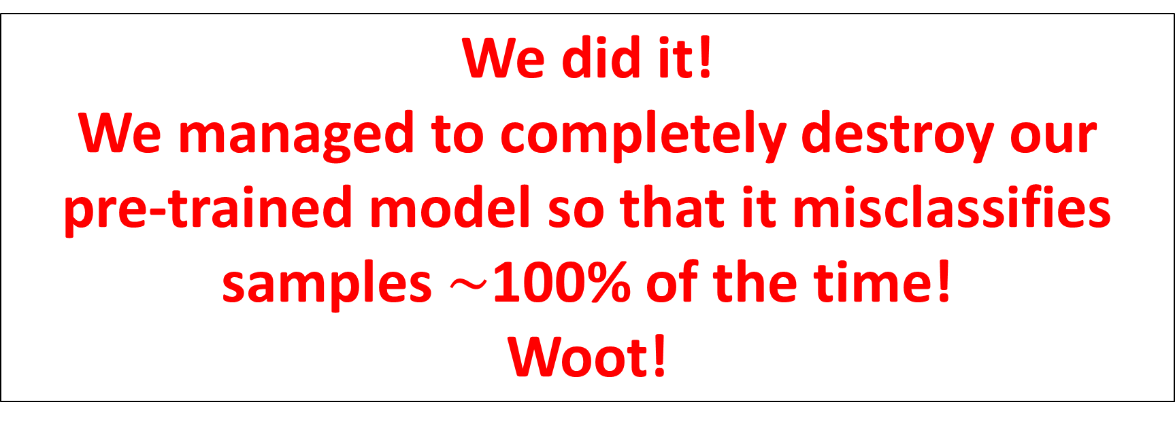
Testing the ITFGSM attack
We did it! We managed to completely destroy our pre-trained model so that it misclassifies samples $\sim$100% of the time!
Woot!

Slide 56
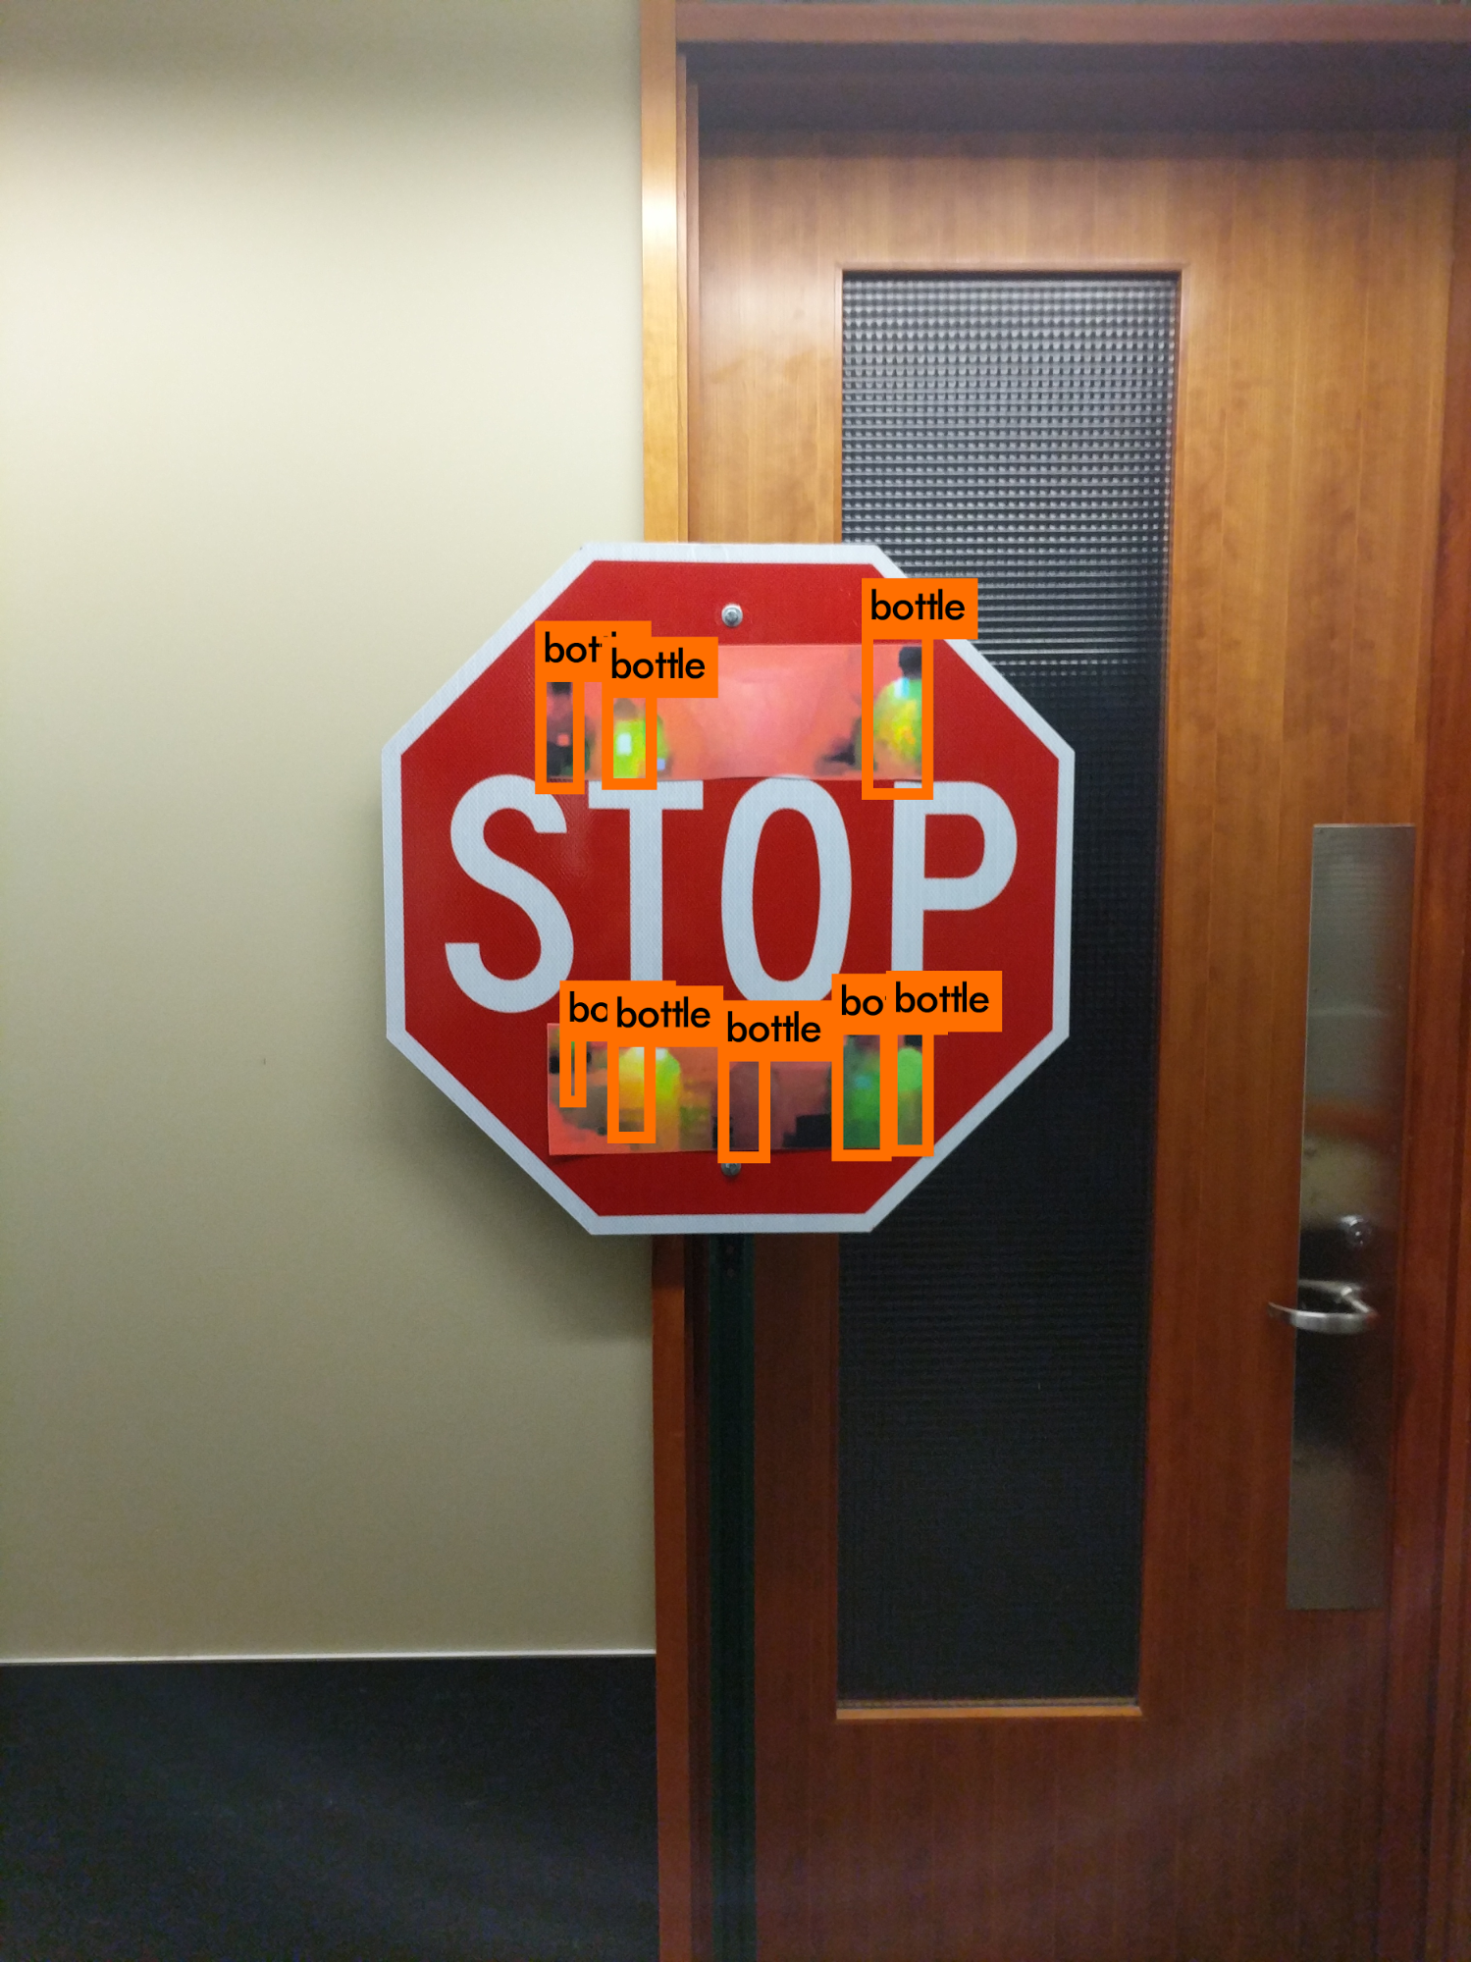

Testing the ITFGSM attack
(Wait, actually, that is scary, I never EVER want to trust a Neural Network again…!)

Slide 57
Remember, there is more… Reason #2: Defense
Definition (Defense on Neural Networks):
In adversarial machine learning, defense refers to machine learning techniques that attempt to protect models from being attacked by malicious attempts.
Important: defense mechanisms often rely on an understanding of how attacks work.
SOMETHING FOR LATER…

Slide 58
Conclusion (W8S2)
Using gradient-based attacks can help produce attacks with higher success rates.
Using Fast Gradient Sign Method gives an extra plausibility constraint, in the form of a max norm constraint between the original image and attack image.
This can lead to a devastating attack!
Iterations were used during training, so might as well use them in attacks as well.
Iterating greatly helps with plausibility.
Iterated FGSM can technically lead to a full failure of our pre-trained model…!
Defense is very much needed!

Slide 59
Learn more about these topics
Out of class, for those of you who are curious
[Goodfellow2015] Goodfellow et al., “Explaining and Harnessing Adversarial Examples“, 2015. https://arxiv.org/abs/1412.6572
[Kurakin2016] Kurakin et al. “Adversarial examples in the physical world”, 2016. https://arxiv.org/abs/1607.02533
Implementing more advanced gradient ascent, e.g. FGSM with gradient ascent and momentum as in [Dong2017] Y. Dong et al. “Boosting Adversarial Attacks with Momentum”, 2017. https://arxiv.org/abs/1710.06081

Slide 60
Learn more about these topics
Tracking important names (Track their works and follow them on Scholar, Twitter, or whatever works for you!)
Alexei Kurakin: Researcher at Google Brain. http://kurakin.me/ https://scholar.google.com/citations?user=nCh4qyMAAAAJ&hl=en
Ian Goodfellow: (Former?) director at Apple and PhD from Stanford, wrote a book that is considered the Bible of Deep Learning, and inventor of GANs (later). https://www.iangoodfellow.com/ https://www.deeplearningbook.org/ https://scholar.google.ca/citations?user=iYN86KEAAAAJ&hl=en

Slide 61
Learn more about these topics
Tracking important names (Track their works and follow them on Scholar, Twitter, or whatever works for you!)
Yoshua Bengio: Professor at University of Montreal, one of the three Godfathers of Deep Learning and 2018 Turing Award winner (highest distinction in Computer Science). https://yoshuabengio.org https://scholar.google.com/citations?user=kukA0LcAAAAJ&hl=fr
Samy Bengio: Senior Director at Apple, inventor of PyTorch (!), (and brother of Yoshua Bengio). https://bengio.abracadoudou.com https://scholar.google.com/citations?user=Vs-MdPcAAAAJ&hl=fr

Slide 62
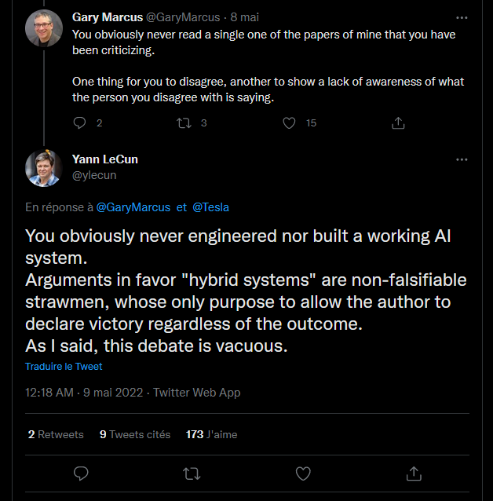
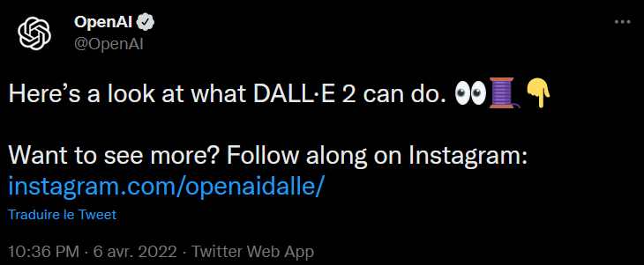
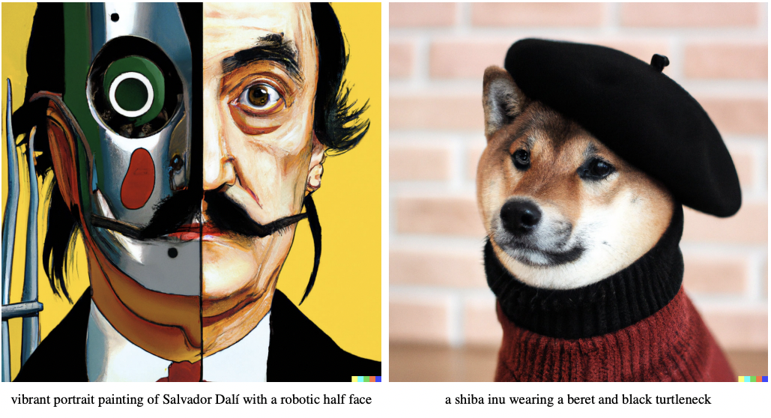
Twitter, the theater for AI/DL drama and announcements
NYU Professor
Announcing Dall-E 2 and its future release
NYU Professor and Chief of AI at Meta (Facebook)

